Slide 1

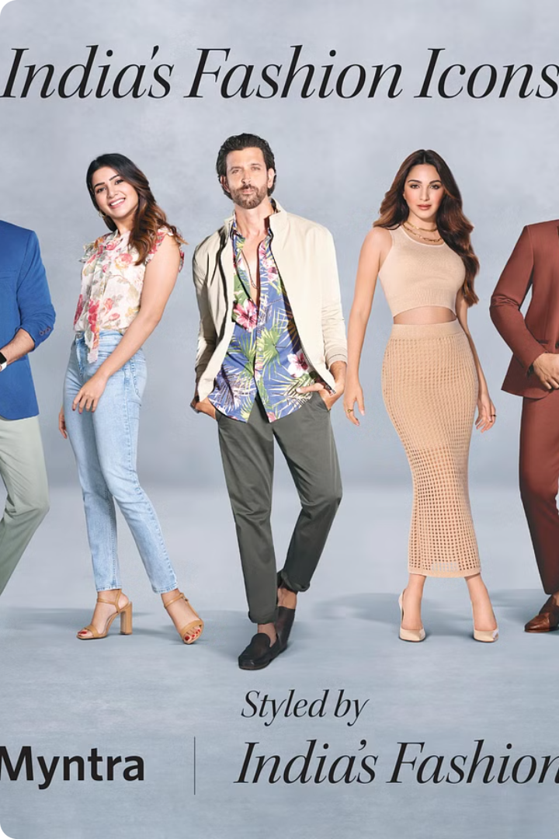


Revitalizing Fashion Engagement for Gen Z
Myntra, a leading e-commerce platform in India, is facing the challenge of engaging Gen Z consumers in the ever-evolving landscape of fast fashion. This demographic craves interactive, personalized experiences and seeks deeper connections with brands. This presentation outlines a strategic approach to address these needs, leveraging social media integration and innovative features to elevate Myntra's platform and drive customer loyalty.
by Jhanvi Jain

Slide 2
The Problem: Declining Engagement
Despite the popularity of online shopping, Gen Z consumers are increasingly disengaged with traditional e-commerce platforms. They seek authentic experiences, personalized recommendations, and real-time interactions with brands and fellow fashion enthusiasts. Traditional browsing and purchasing methods fall short of meeting these expectations, leading to a decline in user engagement and ultimately, brand loyalty.
1
Limited Social Interaction
2
Lack of Personalization
Lack of features that foster social interaction and community building, leading to a passive browsing experience.
Limited personalization options and recommendations, resulting in an impersonal and generic shopping experience.
3
Limited Real-Time Experiences
4
Missed Opportunities for Content
Absence of live events, exclusive product launches, or interactive content that creates a sense of excitement and immediacy.
Limited opportunities to share user-generated content, such as outfit inspiration and styling tips, leading to a lack of engagement and brand advocacy.

Slide 3
The Impact: Lost Revenue and Brand Loyalty
The consequences of declining engagement are significant for Myntra. Reduced app visits, lower conversion rates, and a weakened brand image can result in lost revenue and market share. Moreover, the lack of a vibrant community and authentic connections with Gen Z can hinder brand loyalty and hinder future growth.
Lower Conversion Rates
Reduced App Visits
Weakened Brand Image
The lack of engaging content and interactive features leads to lower conversion rates as users are less inclined to purchase items on the platform.
Users are less likely to return to the app for browsing or purchasing, leading to decreased user retention and engagement.
The lack of innovation and social interaction contributes to a stale and uninspiring brand image, making it less appealing to younger generations.

Slide 4
The Solution: Social Shopping Integration
Myntra needs to implement a comprehensive social shopping strategy that integrates social media functionalities and user-generated content. This will transform the shopping experience into an interactive, engaging, and personalized platform that resonates with Gen Z's preferences.
1
Live Video
Utilize live video for interactive fashion shows, product launches, and influencer collaborations. These events can be used for real-time shopping, Q&A sessions, and exclusive offers, fostering a sense of community and excitement.
2
Virtual Wardrobe
Enable users to create and share virtual wardrobes, allowing them to showcase their style, get feedback, and discover new styling options. This feature promotes user-generated content and encourages social interaction within the app.
3
Social Shopping Features
Integrate social sharing buttons for outfit inspiration, allowing users to share their favorite items on social media platforms. This enables social proof and encourages peer-to-peer recommendations, driving sales and brand awareness.
4
Influencer Marketing
Collaborate with popular fashion influencers to promote products and create engaging content that resonates with Gen Z. Influencer partnerships can drive product discovery, build brand credibility, and increase conversion rates.
5
Shoppable Posts
Enable users to purchase directly from social media platforms, making it easier to shop for products discovered through influencer collaborations and community-generated content.

Slide 5
Feasibility and Tech Stack
Implementing these solutions is both feasible and technologically achievable. Myntra can leverage its existing infrastructure and partnerships with social media platforms to integrate these features seamlessly.
Feature
Technology
Implementation
Live Video
Real-time streaming platforms (e.g., YouTube, Instagram Live)
Integration with Myntra app for live product demonstrations, fashion shows, and influencer collaborations.
Virtual Wardrobe
AR/VR technology, user-generated content platforms
Development of a dedicated virtual wardrobe feature within the Myntra app, enabling users to create and share personalized outfits.
Social Sharing
Social media APIs, content sharing tools
Integration of social media sharing buttons within product pages, enabling users to share their favorite items with their networks.
Shoppable Posts
E-commerce platforms, social media shopping features
Partnerships with social media platforms to enable direct purchases from social media posts.

Slide 6




Benefits of Social Shopping Integration
Implementing a social shopping strategy will bring numerous benefits to Myntra, including increased engagement, higher conversion rates, and a stronger brand image. This approach will help Myntra stay ahead of the curve in the ever-changing landscape of e-commerce, particularly in the context of Gen Z's evolving shopping habits.
Increased Engagement
Higher Conversion Rates
Stronger Brand Image
Growth and Expansion
Social shopping features drive user interaction, foster a sense of community, and encourage frequent app visits, leading to increased engagement and brand loyalty.
Interactive experiences, personalized recommendations, and social proof through user-generated content contribute to higher conversion rates, translating into increased sales and revenue.
Myntra establishes itself as a cutting-edge platform that understands and caters to Gen Z's preferences, leading to a more positive and engaging brand image.
Social shopping features can attract new users and expand Myntra's reach, making it the go-to platform for Gen Z fashion enthusiasts in India.

